Slide 1
Welcome to Javascript

Slide 2
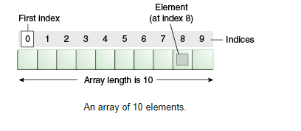
What is array

Slide 3
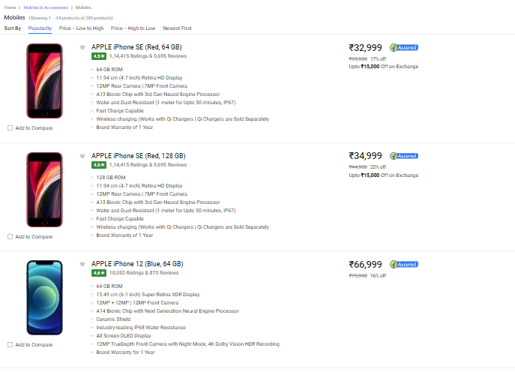
Real world problem- ecommerce

Slide 4
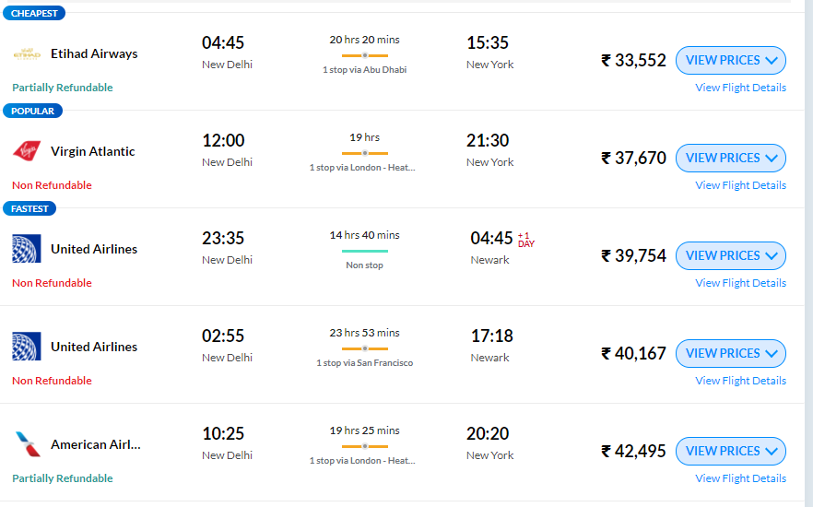
Real world problem - transport

Slide 5
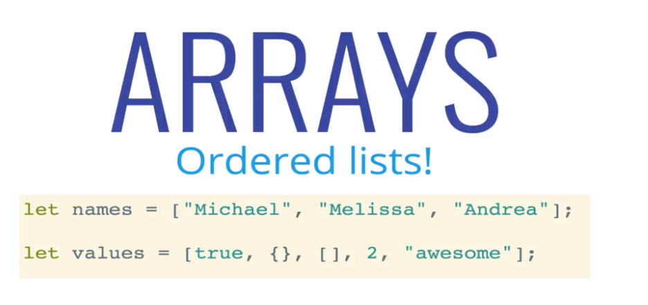
What is array

Slide 6
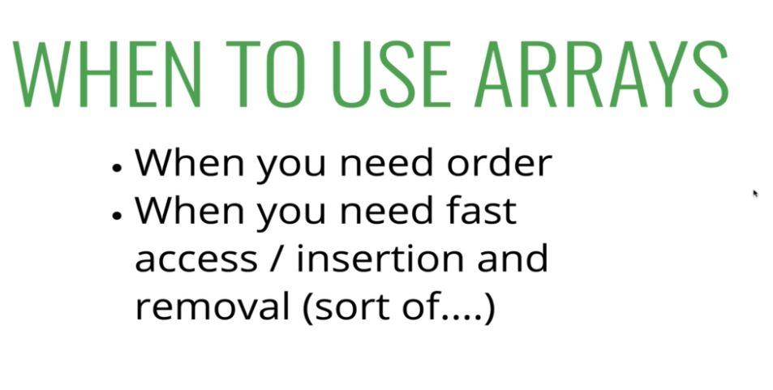
Array?

Slide 7
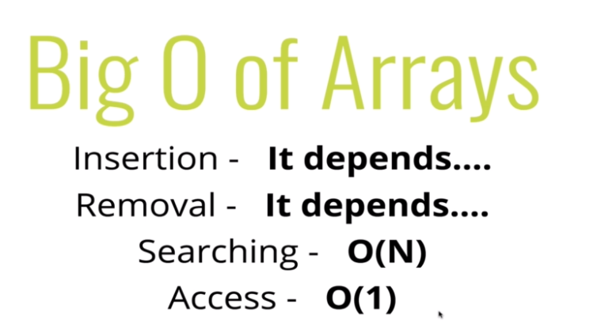
Space and time complexity

Slide 8
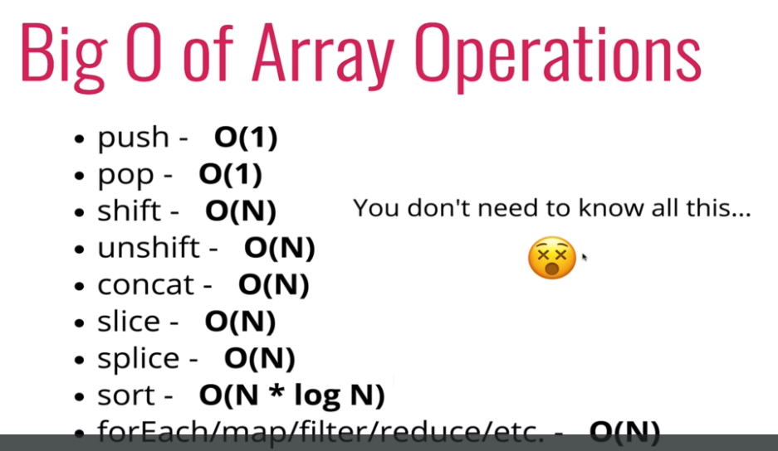
Built in function complexity

Slide 9
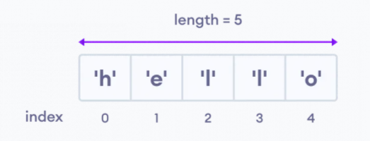
Array
An array is an object that can store multiple values, create an array is by using an array literal []
Create Array:
Access Elements of an Array:
Example:
// empty array
const myList = [ ];
// array of numbers
const numberArray = [ 2, 4, 6, 8];
// array of strings
const stringArray = [ 'eat', 'work', 'sleep'];
// array with mixed data types
const newData = ['work', 'exercise', 1, true];
Example:
const myArray = ['h', 'e', 'l', 'l', 'o'];
// first element
console.log(myArray[0]); // "h“
// second element
console.log(myArray[1]); // "e"

Slide 10
Array Methods
An array is an object that can store multiple values, create an array is by using an array literal []
Arrays to Strings:
const elec = [“Mobile", “Ipad", “Laptop", “Chargers"];
console.log(elec.toString())
join():
const elec = [“Mobile", “Ipad", “Laptop", “Chargers"];
console.log(elec.join("-"))
//mobile-ipad-laptop-charges
Add an Element to an Array:
push() and unshift() to add elements to an array
let dailyActivities = ['eat', 'sleep'];
// add an element at the end
dailyActivities.push('exercise');
console.log(dailyActivities); // ['eat', 'sleep', 'exercise']
let dailyActivities = ['eat', 'sleep'];
//add an element at the start
dailyActivities.unshift('work');
console.log(dailyActivities); // ['work', 'eat', 'sleep']

Slide 11
Array Methods
Change the Elements of an Array:
Add elements or Change the elements by accessing the index value
let dailyActivities = [ 'eat', 'sleep'];
// this will add the new element 'exercise' at the 2 index
dailyActivities[2] = 'exercise';
console.log(dailyActivities); // ['eat', 'sleep', 'exercise']
Remove an Element from an Array:
pop() method to remove the last element from an array. The pop() method also returns the removed element
shift() method removes the first element and also returns the removed element
let dailyActivities = ['work', 'eat', 'sleep', 'exercise'];
// remove the last element
dailyActivities.pop();
console.log(dailyActivities); // ['work', 'eat', 'sleep']
// remove the last element from ['work', 'eat', 'sleep']
const removedElement = dailyActivities.pop();
let dailyActivities = ['work', 'eat', 'sleep'];
// remove the first element
dailyActivities.shift();
console.log(dailyActivities); // ['eat', 'sleep']

Slide 12
Array Methods
Array Length:
Number of elements in an array using the length property
Concat:
The concat() method creates a new array by merging existing array
const dailyActivities = [ 'eat', 'sleep'];
// this gives the total number of elements in an array
console.log(dailyActivities.length); // 2
const myDailyAct = [ 'eat', 'sleep'];
const myAddiction = [“work", “play", “roam"];
const myChildren = myDailyAct.concat(myAddiction);
splice():
The splice() method can be used to add new items to an array
The first parameter (2) defines the position where new elements should be added.
The second parameter (0) defines how many elements should be removed.
The rest of the parameters ("Lemon" , "Kiwi") define the new elements to be added.
const fruits = ["Banana", "Orange", "Apple", "Mango"];
fruits.splice(2, 0, "Lemon", "Kiwi");
const remItems = fruits.splice(2, 2, "Lemon", "Kiwi");
// to remove items
const fruits = ["Banana", "Orange", "Apple", "Mango"];
fruits.splice(0, 1);

Slide 13
Array Methods
slice():
The slice() method slices out a piece of an array into a new array
The slice() method does not remove any elements from the source array.
const fruits = ["Banana", "Orange", "Lemon", "Apple", "Mango"];
const citrus = fruits.slice(2);
//slice() method can take two arguments like slice(1, 3)
const citrus = fruits.slice(1,4);
Sorting an Array:
The sort() method sorts an array alphabetically
Reversing an Array:
The reverse() method reverses the elements in an array
const fruits = ["Banana", "Orange", "Apple", "Mango"];
fruits.sort();
const fruits = ["Banana", "Orange", "Apple", "Mango"];
fruits.reverse();

Slide 14
Array Methods
indexOf():
searches an element of an array and returns its position
//finding the index position of string
const position = dailyActivities.indexOf('work');
console.log(position); // 2
includes():
The includes() method returns true if an array contains a specified value
const fruits = ["Banana", "Orange", "Apple", "Mango"];
fruits.includes("Mango");
isArray():
Check if an object is an array
const fruits = ["Banana", "Orange", "Apple", "Mango"];
let result = Array.isArray(fruits); // true
let text = “testStringArray";
let result = Array.isArray(text); // false

Slide 15
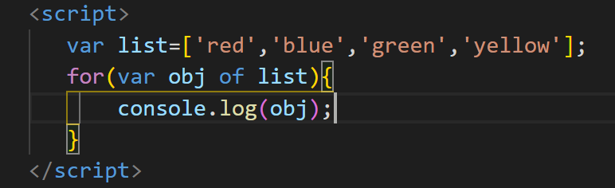
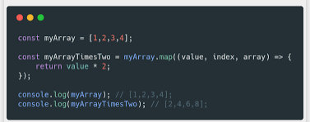
Array Loops – For & Foreach
for:
const fruits = ["Banana", "Orange", "Apple", "Mango"];
for (let i = 0; i < fruits.length; i++) {
console.log(fruits[i]);
}
foreach():
const fruits = ["Banana", "Orange", "Apple", "Mango"];
fruits.forEach(function(item){
console.log(item);
})

Slide 16
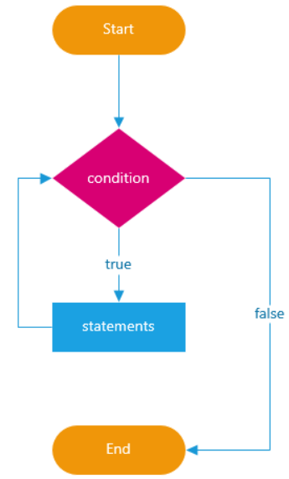
JavaScript Loops
In programming, loops are used to repeat a block of code
For example, if you want to show a message 100 times, then you can use a loop. It's just a simple example; you can achieve much more with loops.
For loop
While loop
do while

Slide 17
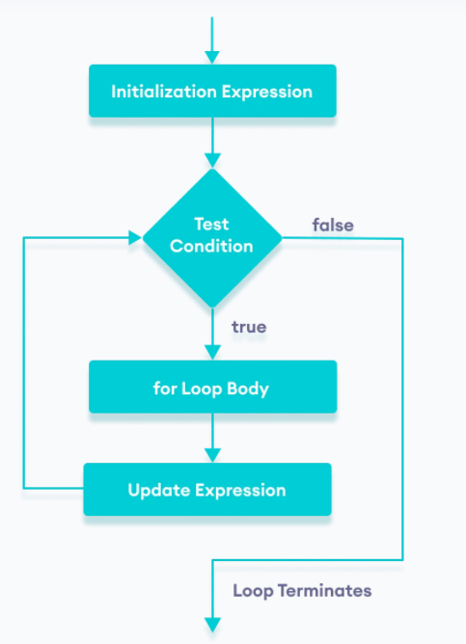
JavaScript Loops - for
The for loop requires following three parts.
Initializer: Initialize a counter variable to start with
Condition: specify a condition that must evaluate to true for next iteration
Iteration: increase or decrease counter
Syntax
for(initializer; condition; iteration)
{
// Code to be executed
}
Example
for (var i = 0; i < 5; i++)
{
console.log(i);
}
let n = 5;
// looping from i = 1 to 5
for (let i = 1; i <= n; i++) {
console.log(`I am learning JavaScript.`);
}

Slide 18
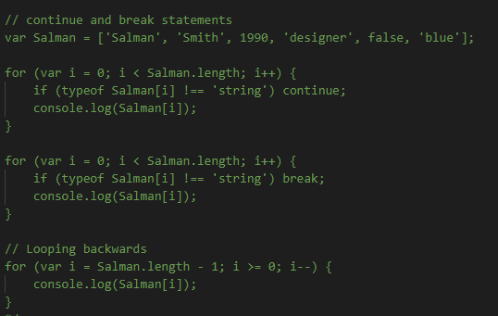
Continue and break statement

Slide 19
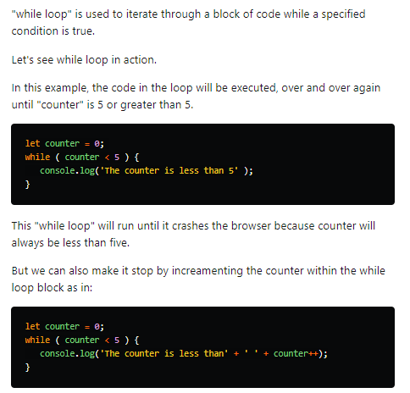
While Loop

Slide 20
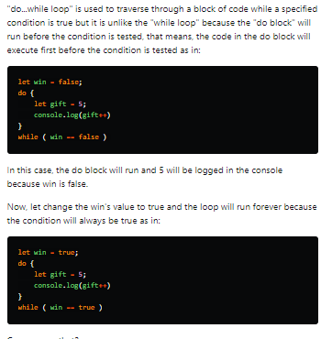
Do While Loop

Slide 21
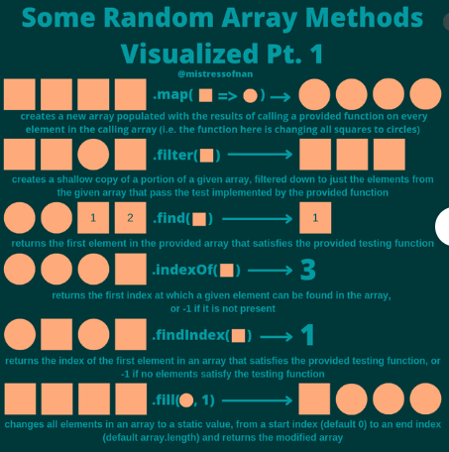
Other Loops

Slide 22
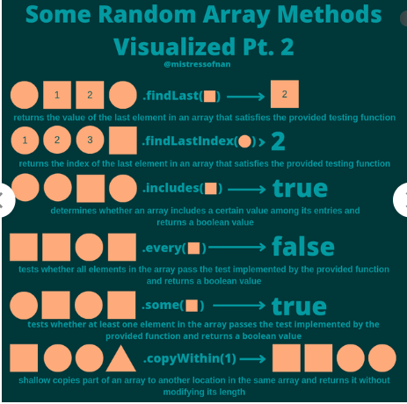
Other Loops

Slide 23
Other Loops

Slide 24
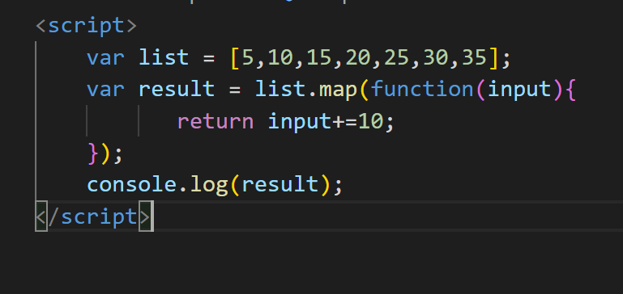

Map

Slide 25
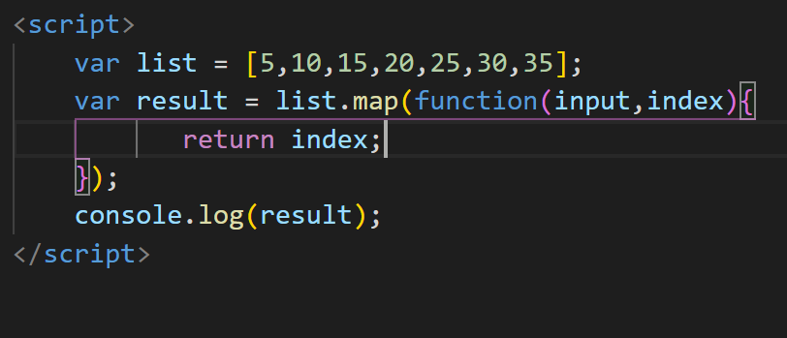

Map with index value

Slide 26
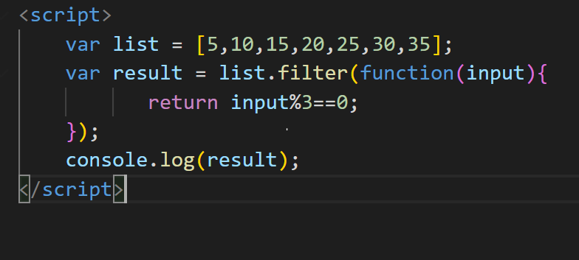

Filter

Slide 27
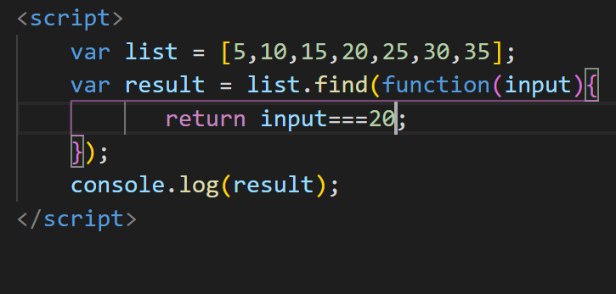

Find

Slide 28
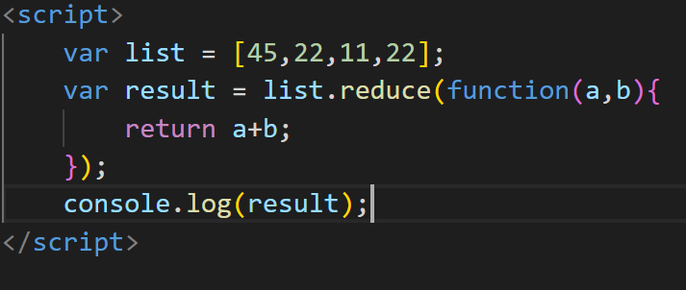
reduce

Slide 29
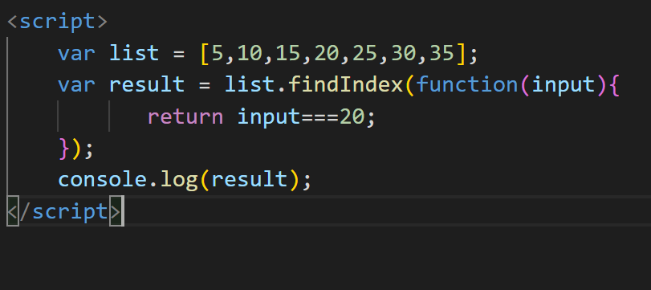
findIndex

Slide 30
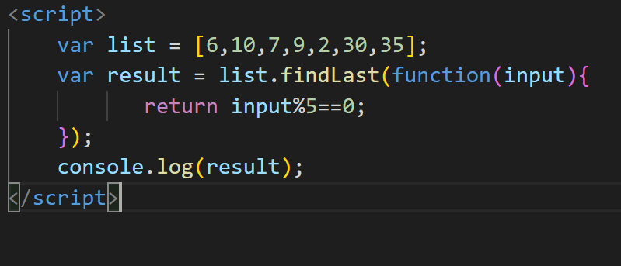
findLast

Slide 31
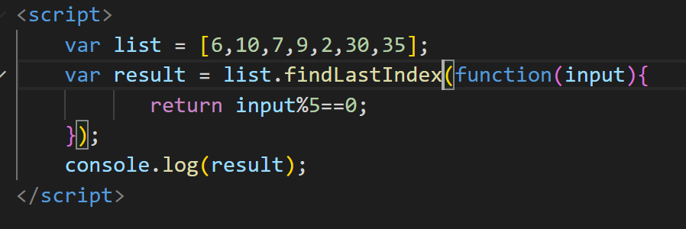
findLastIndex

Slide 32
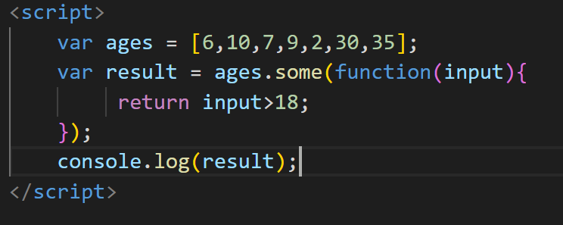

some

Slide 33
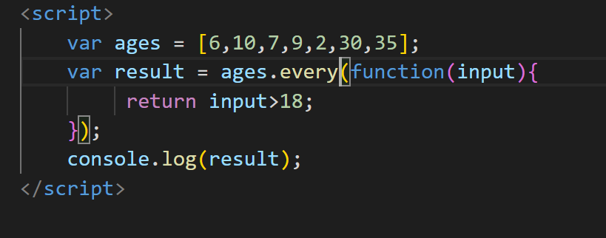

every

Slide 34
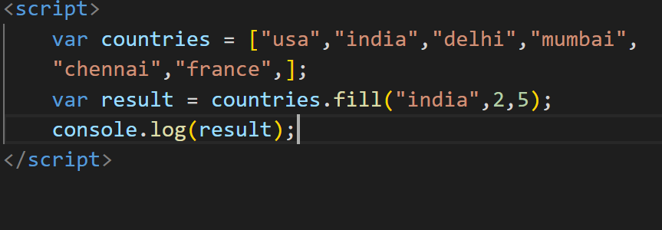
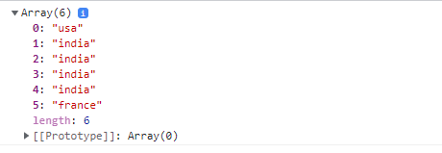
Fill

Slide 35
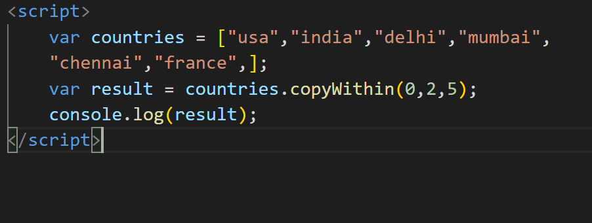
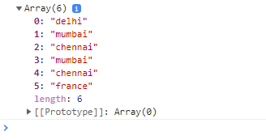
copywithin

Slide 36
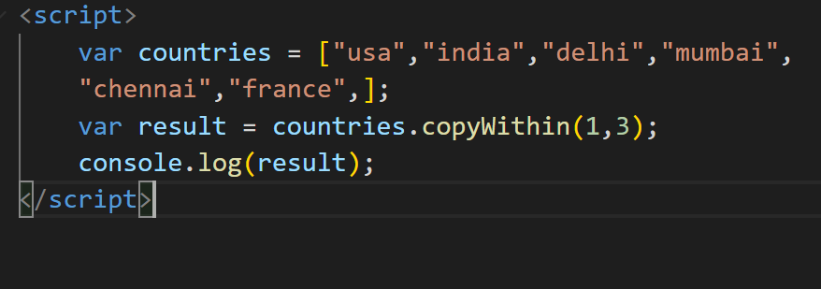

Copywithin

Slide 37
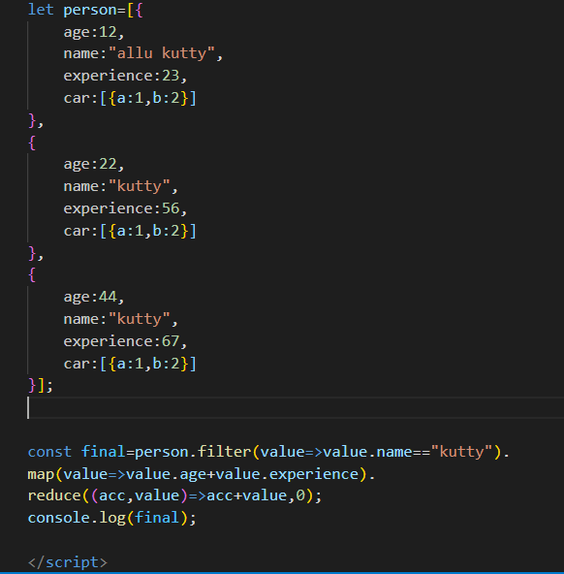
Map,Filter,Reduce

Slide 38
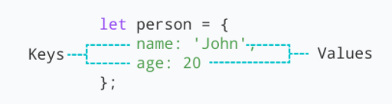
Object
JavaScript object is a non-primitive data-type that allows you to store multiple collections of data
Syntax:
const object_name = {
key1: value1,
key2: value2
}
// object creation
let person = {
name: 'John',
age: 20
};
console.log(typeof person); // object
"key: value" pairs are called properties

Slide 39
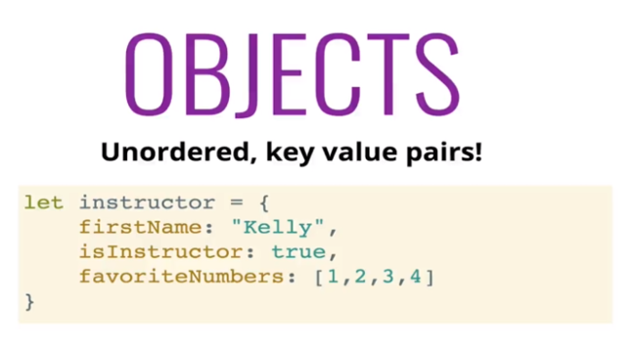
What is object

Slide 40
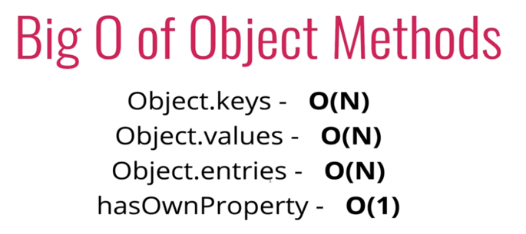
Time and space complexity

Slide 41
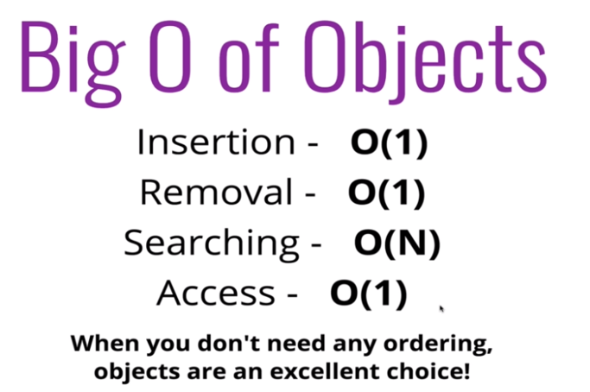
When to use it?

Slide 42
Object
Accessing Object Properties:
Syntax:
objectName.key
Or
objectName["propertyName"]
const person = {
name: 'John',
age: 20,
};
// accessing property
console.log(person.name); // John
const person = {
name: 'John',
age: 20,
};
// accessing property
console.log(person["name"]); // John

Slide 43
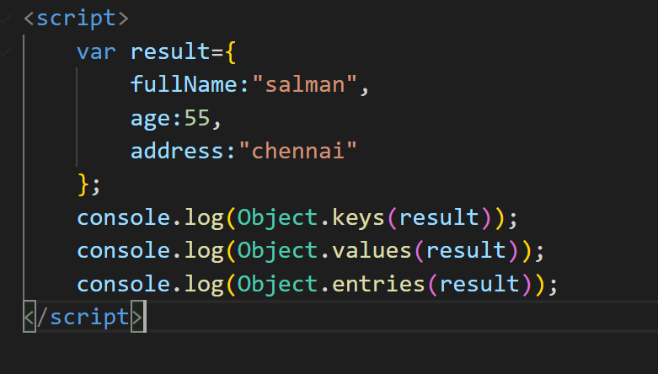
Object – for…in
Loop through an object Using for...in
const student = {
name: 'John',
age: 20,
hobbies: ['reading', 'games', 'coding'],
};
// using for...in
for (let key in student) {
let value;
// get the value
value = student[key];
console.log(key + " - " + value);
}

